Slide 1





A Comparative study on Deep learning approaches for prevention of DDOS Attack by BOTNET infected IoT devices.
Kavya S
Sarath T S
Siddharth M
Abitha S
Akhil Kuriakose

Slide 2
Current Scenario
IoT basic functions(camera , etc..)
Old OS still used by manufactures
Manufacture providing read-only contents like logins
as admin admin
Remote command interface
Manufacture fixed vulnerability: but attackers abuse it instantly
Major: MIRAI, BASHLITE

Slide 3
How attacks developed?
IoT Search Engines :
Shodan, Censys – They continuously scans IP address and connect to Telnet, webservers etc.
API’s available for infecting one by one

Slide 4









Current Attacks:
Botnet DDOS Attack
Mining Cryptocurrency Attacks
Bitcoin Miners Had Vulnerability And Could Be Affected By IoT BOTNETs
Changing wallet addresses by using bots in cryptocurrency miners

Slide 5
Prevention possible at the moment:
Best Bet Is To Use Firewall And Try To Update It Always.
But It Cannot Help To Prevent A Particular DDOS Attack at a Moment

Slide 6
Using Deep learning:
With help of Artificial Intelligence we can use deep learning algorithms to help classify whether a packet received is from a botnet infected device or not.
So by training the model with lot of malformed packets we can accurately predict if an upcoming packet is from an infected device.
We do a comparative study to bring out the best algorithm suited for the BOTNET detection by measuring accuracies of different algorithms.

Slide 7
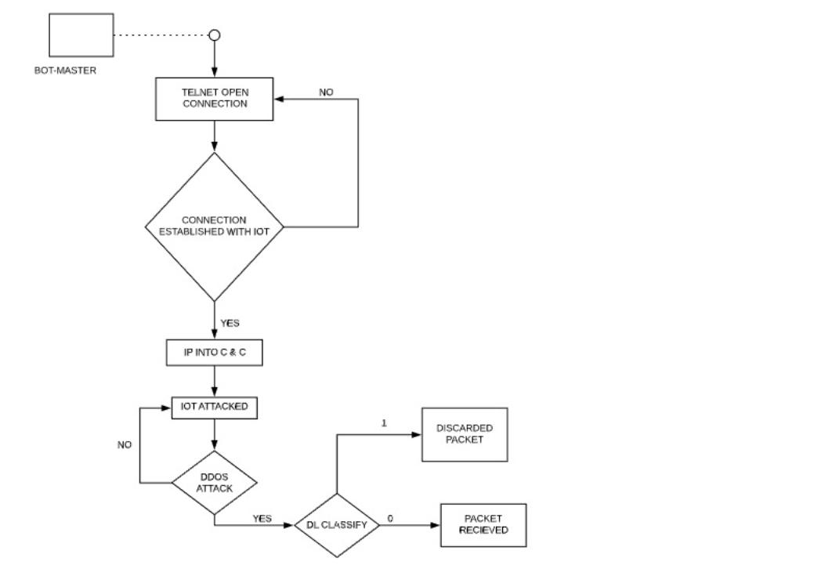
Activity Diagram

Slide 8

Deep Learning Concepts:
Convolutional neural network (CNN)
Recurrent neural network (RNN)
Long short-term memory (LSTM)

Slide 9
Software Required:
Deep learning Studio
Arduino IDE
UFONet
EtterCap
Wireshark – Packet Analysis
Anaconda Navigator
Spyder / Jupyter Notebook
Google Colabs

Slide 10
Operating Systems:
Kali Linux – Collecting Attack datasets, Attack tools
Raspbian OS – For Rasberry pi
Debian – For packet sniff , analysis and prediction

Slide 11
Hardware Required:
Rasberry pi 3 Model B / Arduino UNO
PC with 8 GB RAM, GPU : NVIDIA 1050 TI + (Preferred)

Slide 12
Languages and Libraries:
Python
C++
Tensorflow / Pytorch
Scikit-learn , Matplotlib , Pandas

Slide 13

Thanks!

